Slide 1
Progressive Report
Sangwoo Kim
Department of Mechanical Engineering,
Gachon University, Korea
2022-08-12

Slide 2
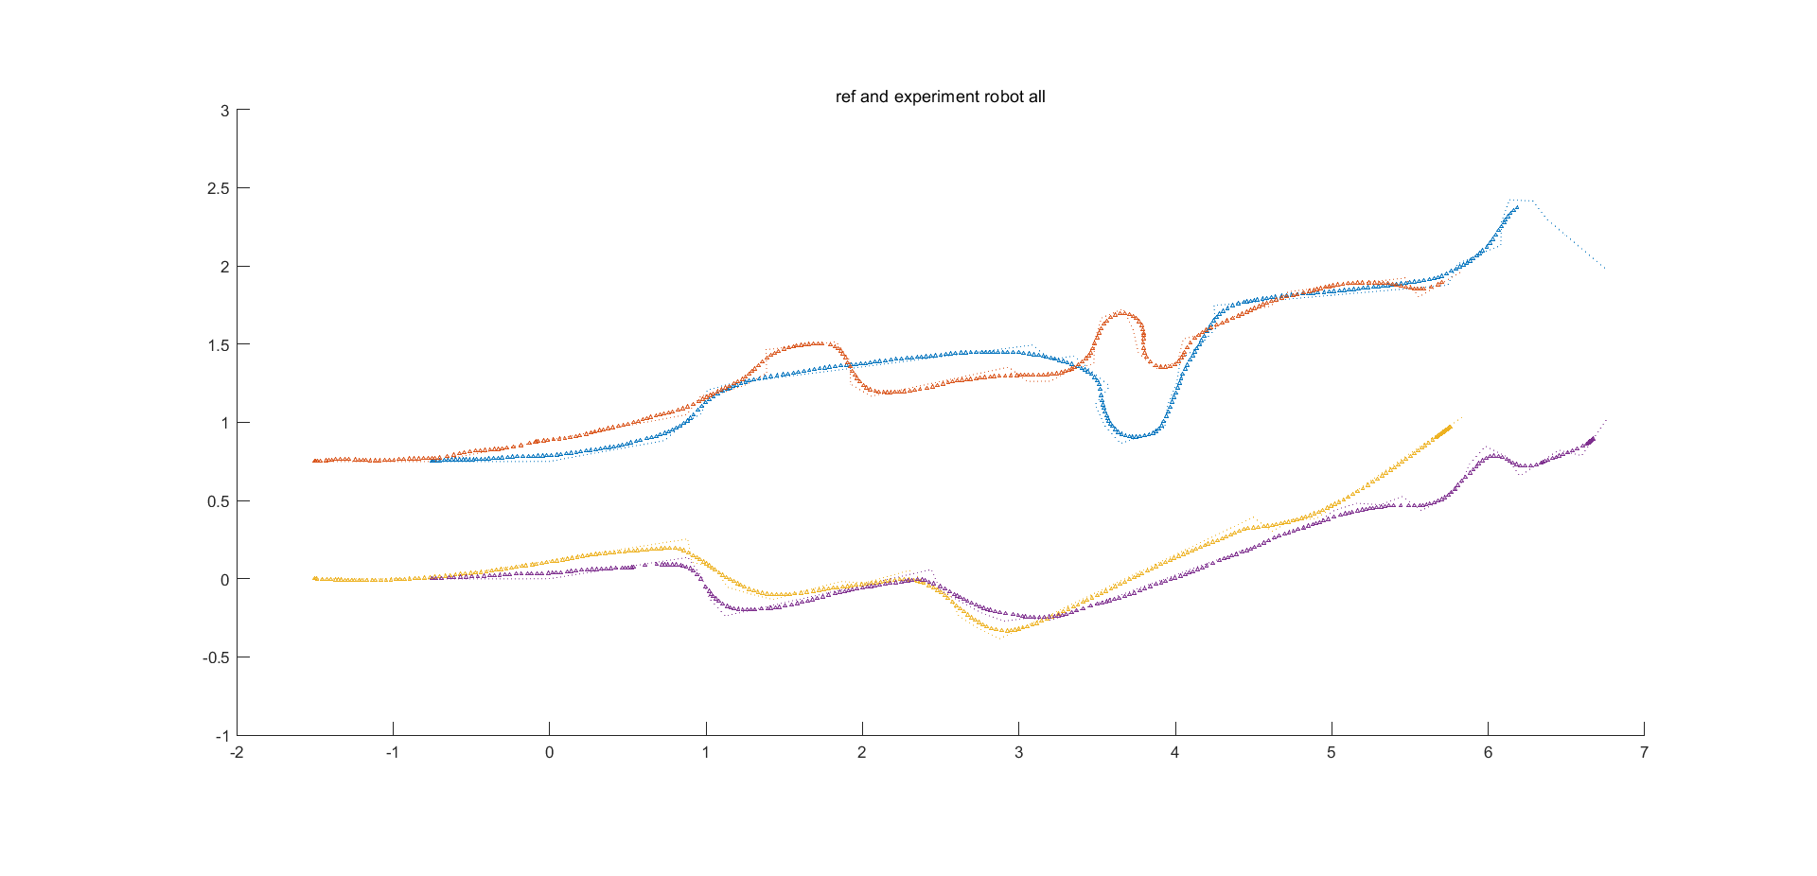
Video processing
Plot data graph : reference, experiment (IMU & encoder)
Obviously, the experimental data follows the reference data well.

Slide 3
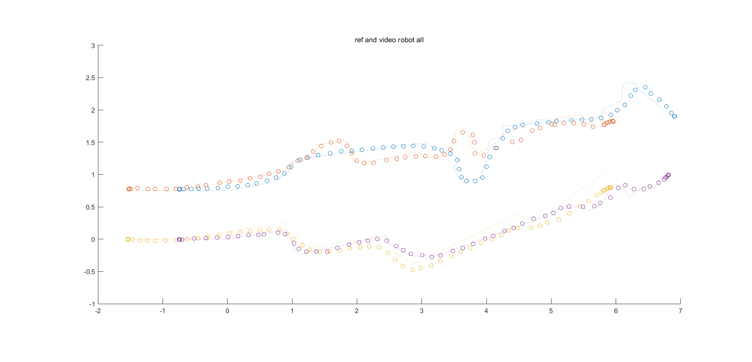
Video processing
Plot data graph : reference, video
Robot : all
Data are plotted but, hard to introspect, it is tangled.

Slide 4
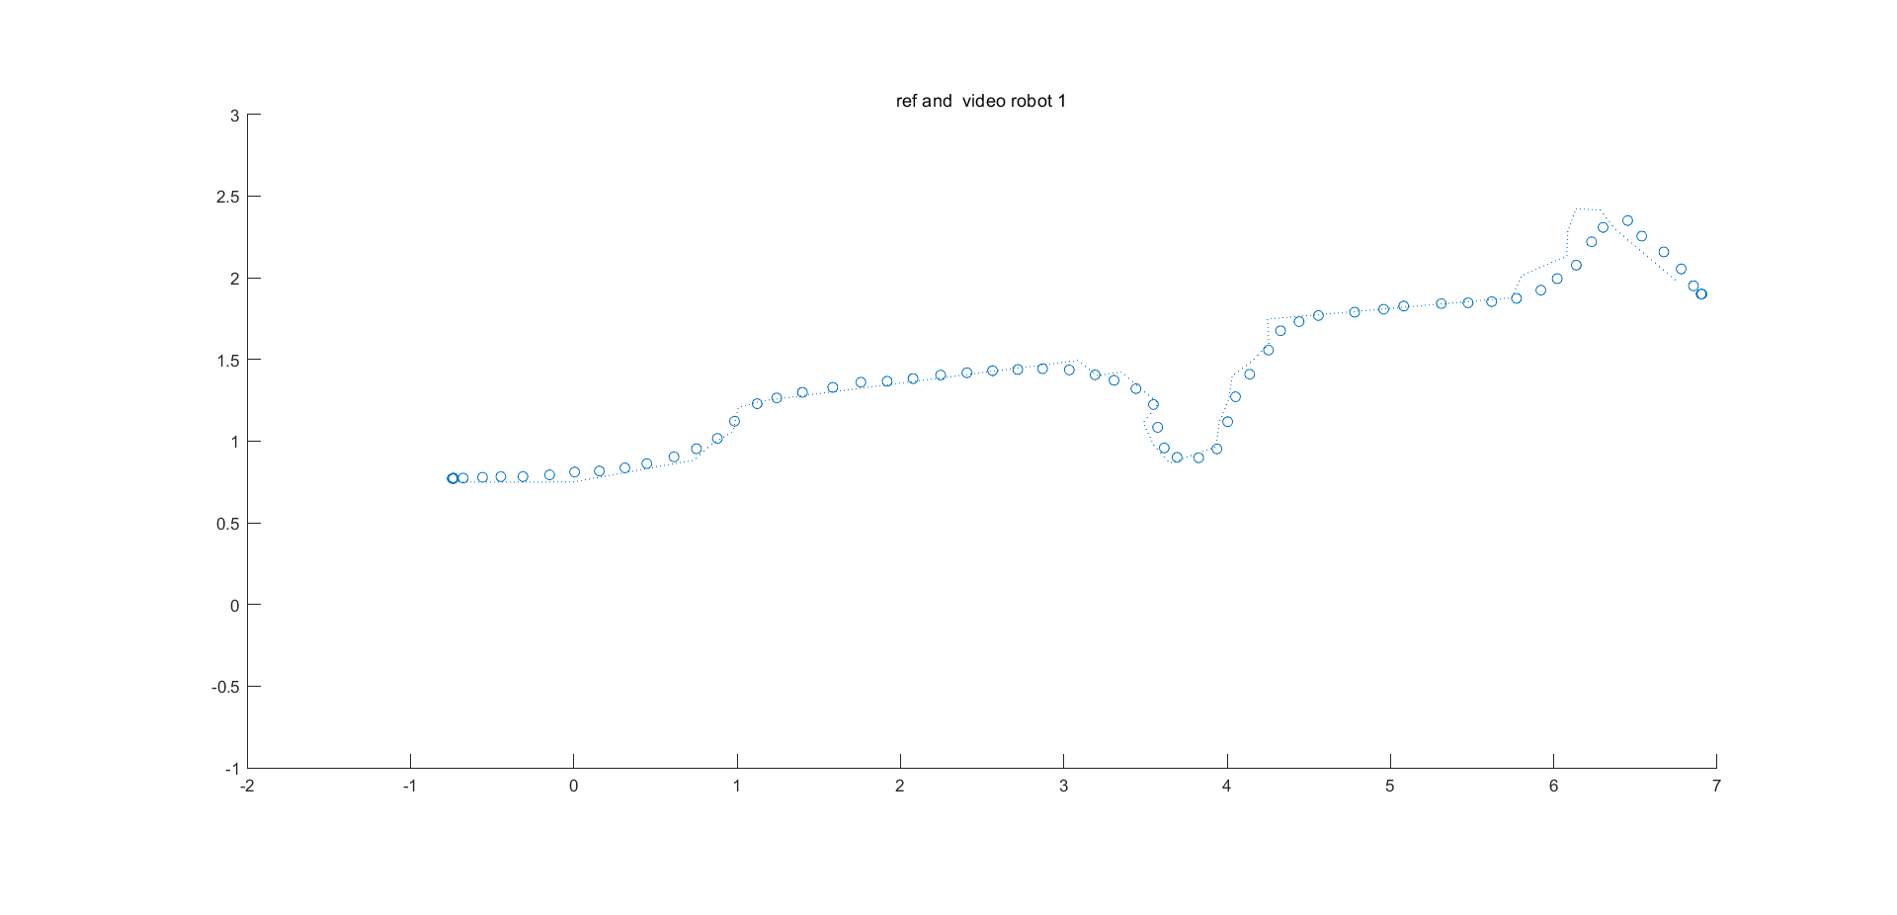
Video processing
Plot data graph : reference, video
Robot : 1
Data follows reference, excellent, almost perfect
Point 14th have Little error, the cause is unknown yet
No, a particular point in experiment log
14
Experiment
localization log data

Slide 5
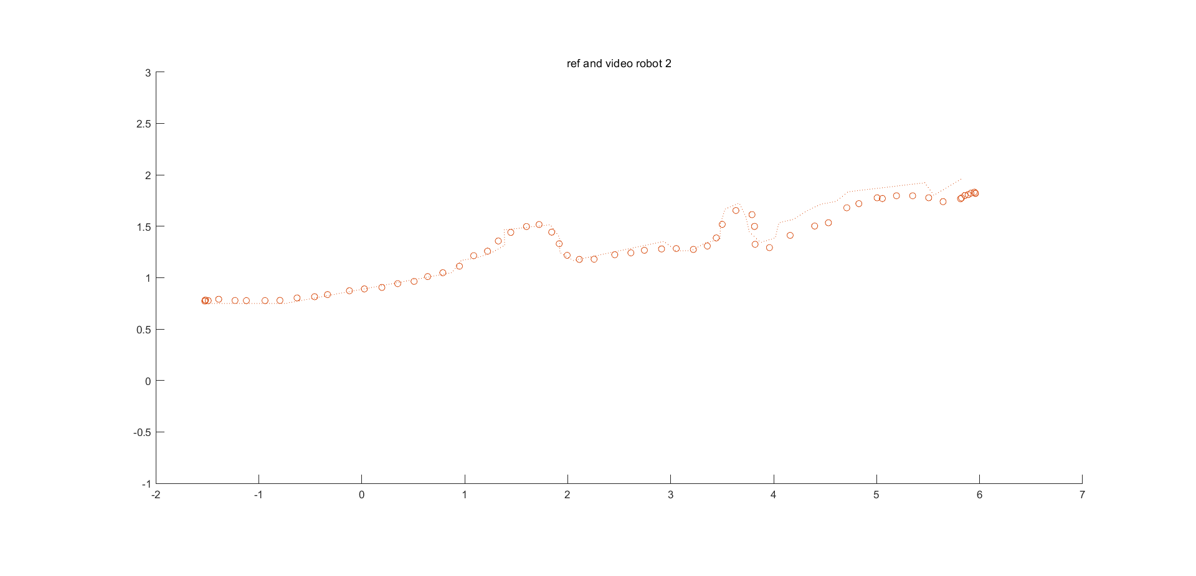
Video processing
Plot data graph : reference, video
Robot : 2
Video datum follows reference until 4 meter, but after points data have significant error

Slide 6
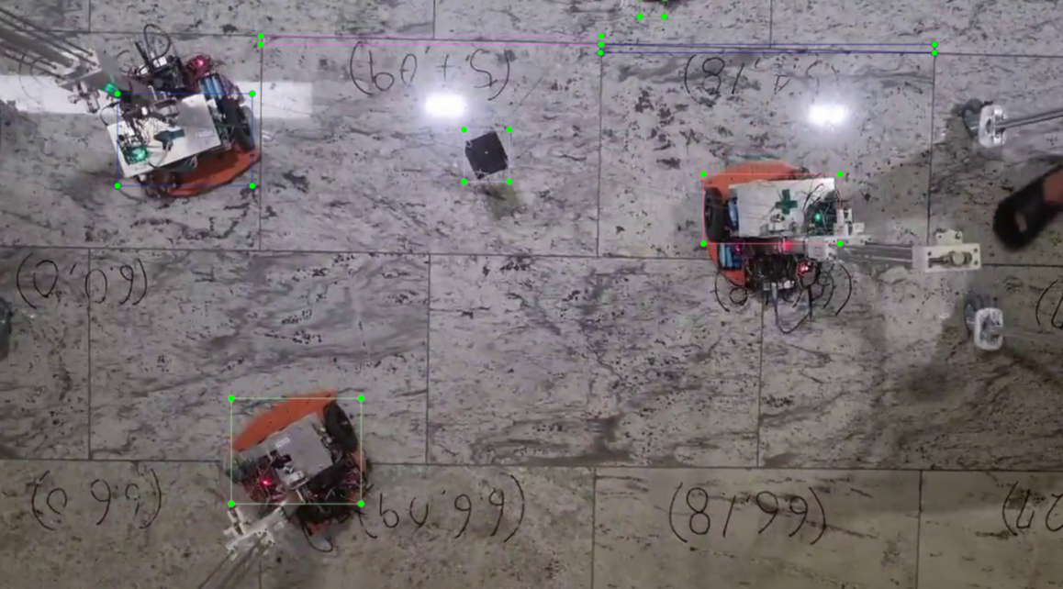
Video processing
Robot case 2 analyze
Robot 2 goes out of video frame
Therefore, labelling box could not represent Robot 2 postion
Point 12 picture

Slide 7
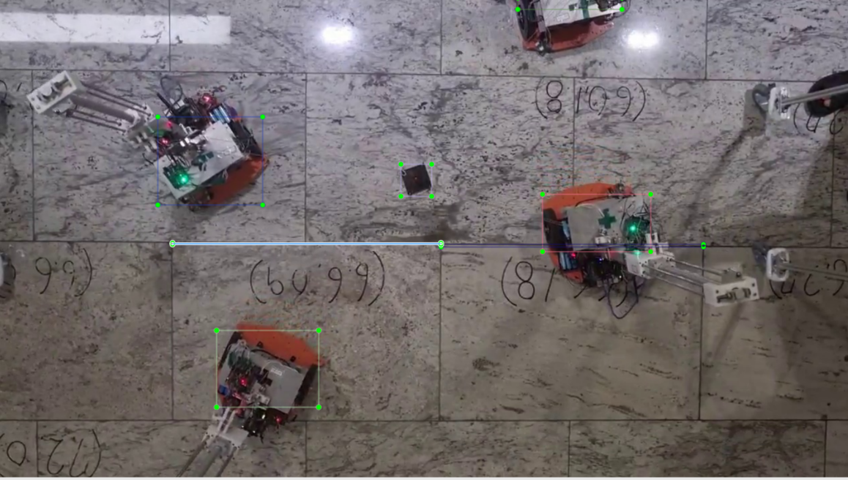
Video processing
Robot case 2 analyze
Robot 2 goes out of video frame, “LITTLE”
Therefore, labelling box might not represent Robot 2 position
It is not significant
Point 13 picture

Slide 8
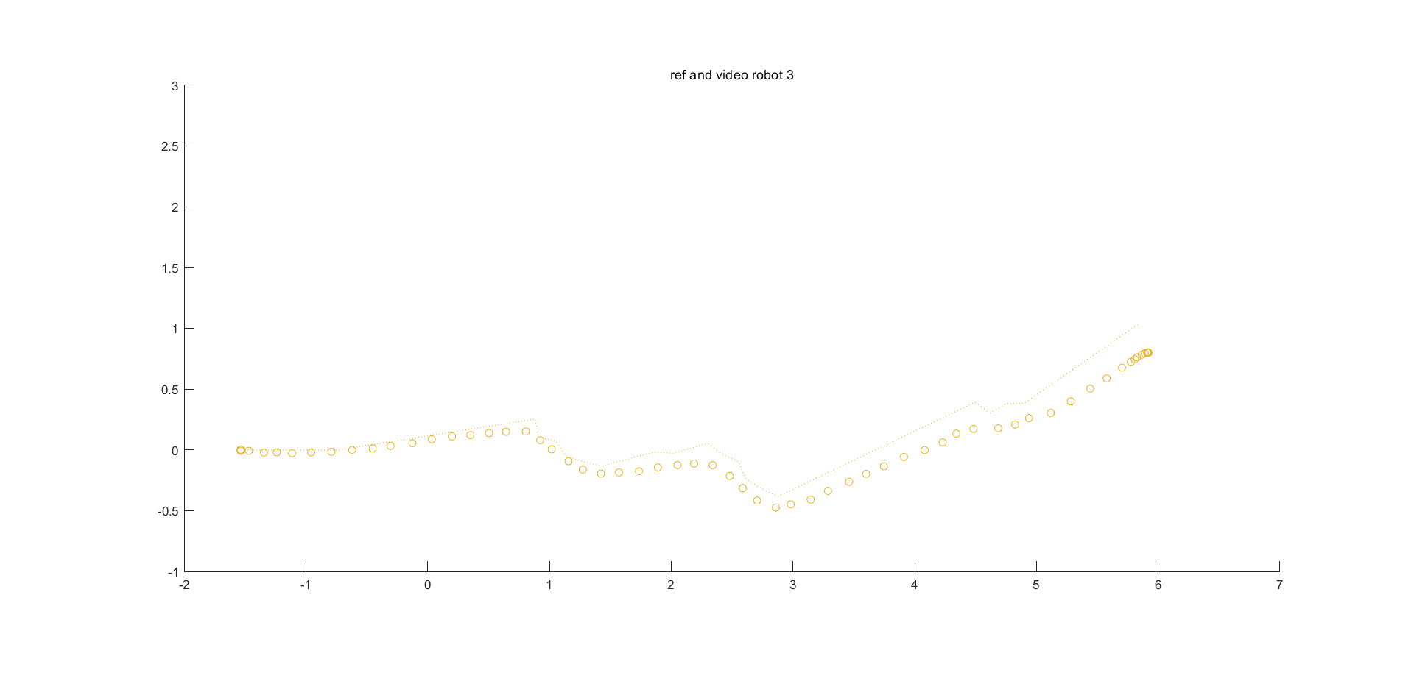
Video processing
Plot data graph : reference, video
Robot : 3
Robot following is drifting form reference data since near of point 5th
4
5
6

Slide 9
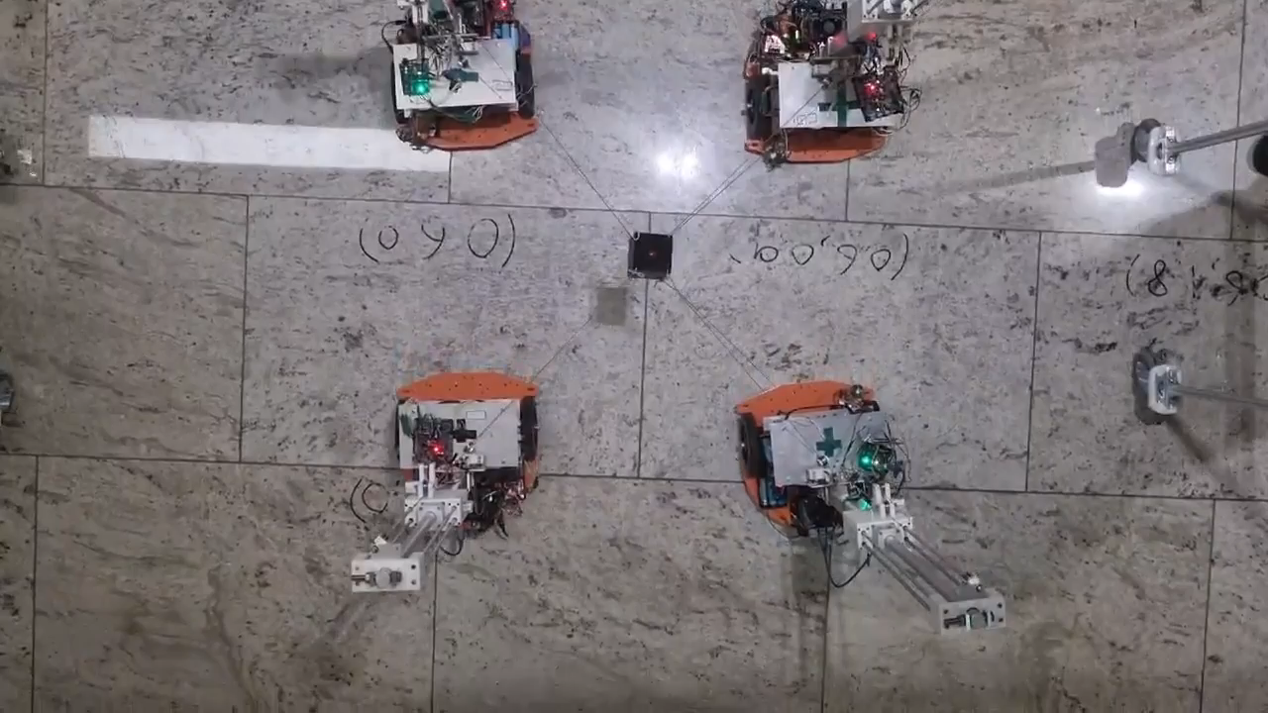
Video processing
Robot case 3 analyze
Robot 2 was pulled by its cable, the cause would be communication error between Arduino and Dynamixel servo motor.
Therefore, direction of robot would be changed that not be reflected in localization and it would occur error after point 5th
Cable length decrease
in experiment log
Video clip at
middle of
Near of point 4th
(x = 0.65, x_grid = 1.4)

Slide 10
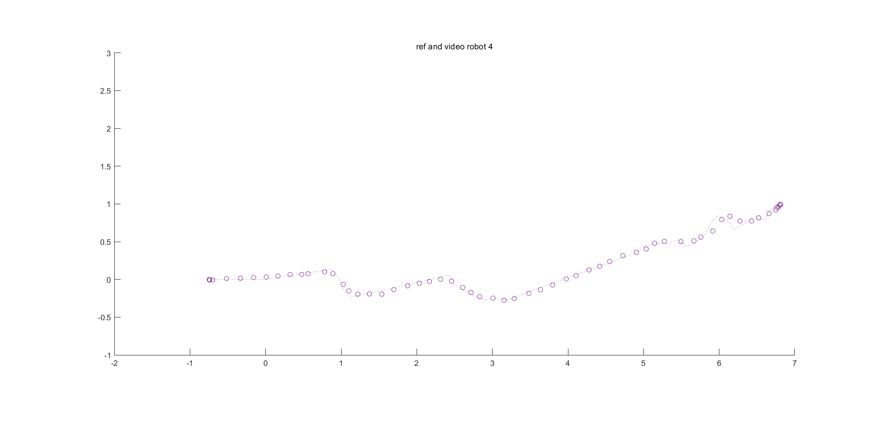
Video processing
Plot data graph : reference, video
Robot : 4
Data follows reference, excellent, perfect
Its error will be smaller than human error that have occurred, during drawing label box by hands

Slide 11
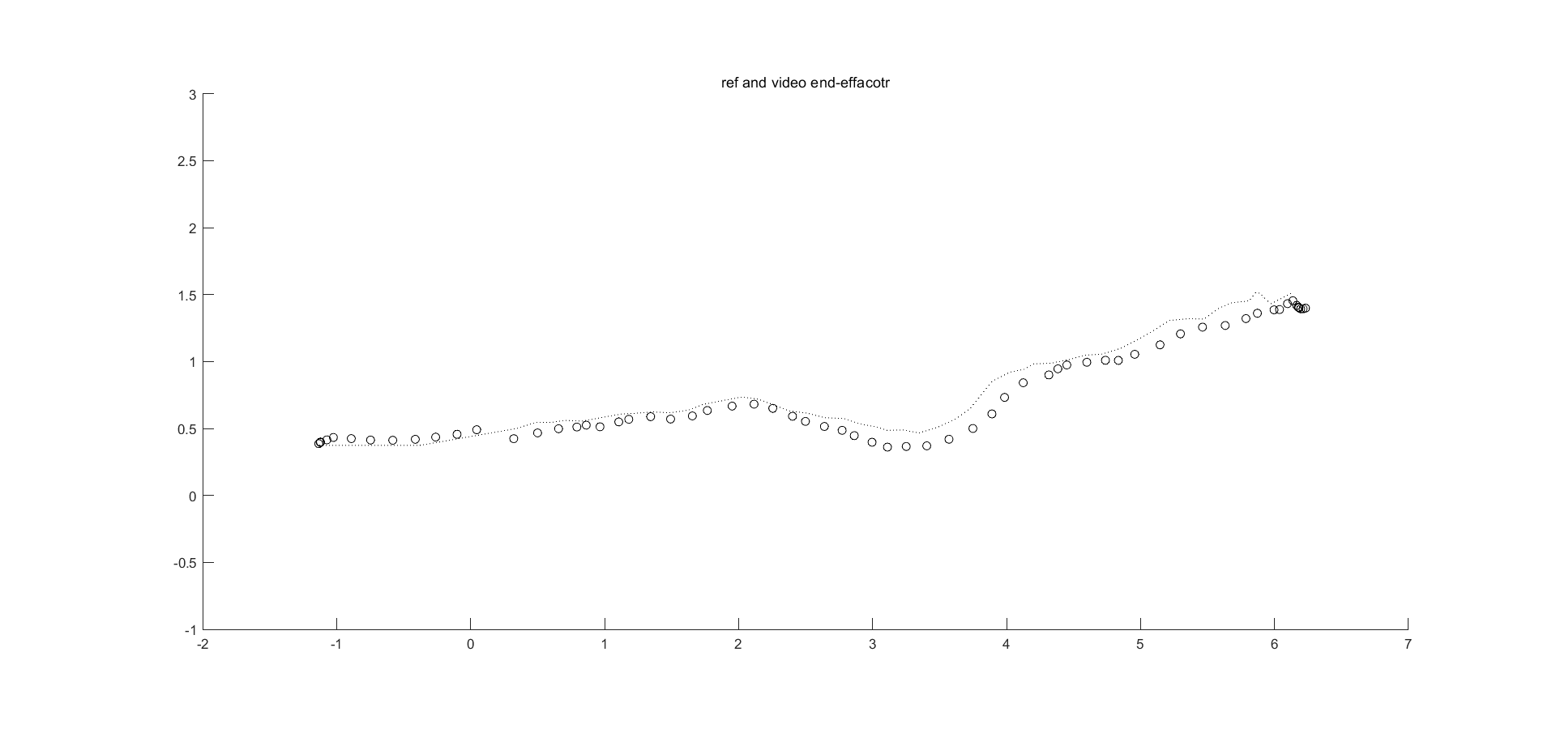
Video processing
Plot data graph : reference, video
End-effector
Data follows reference but there are omnidirectional error

